Slide 3
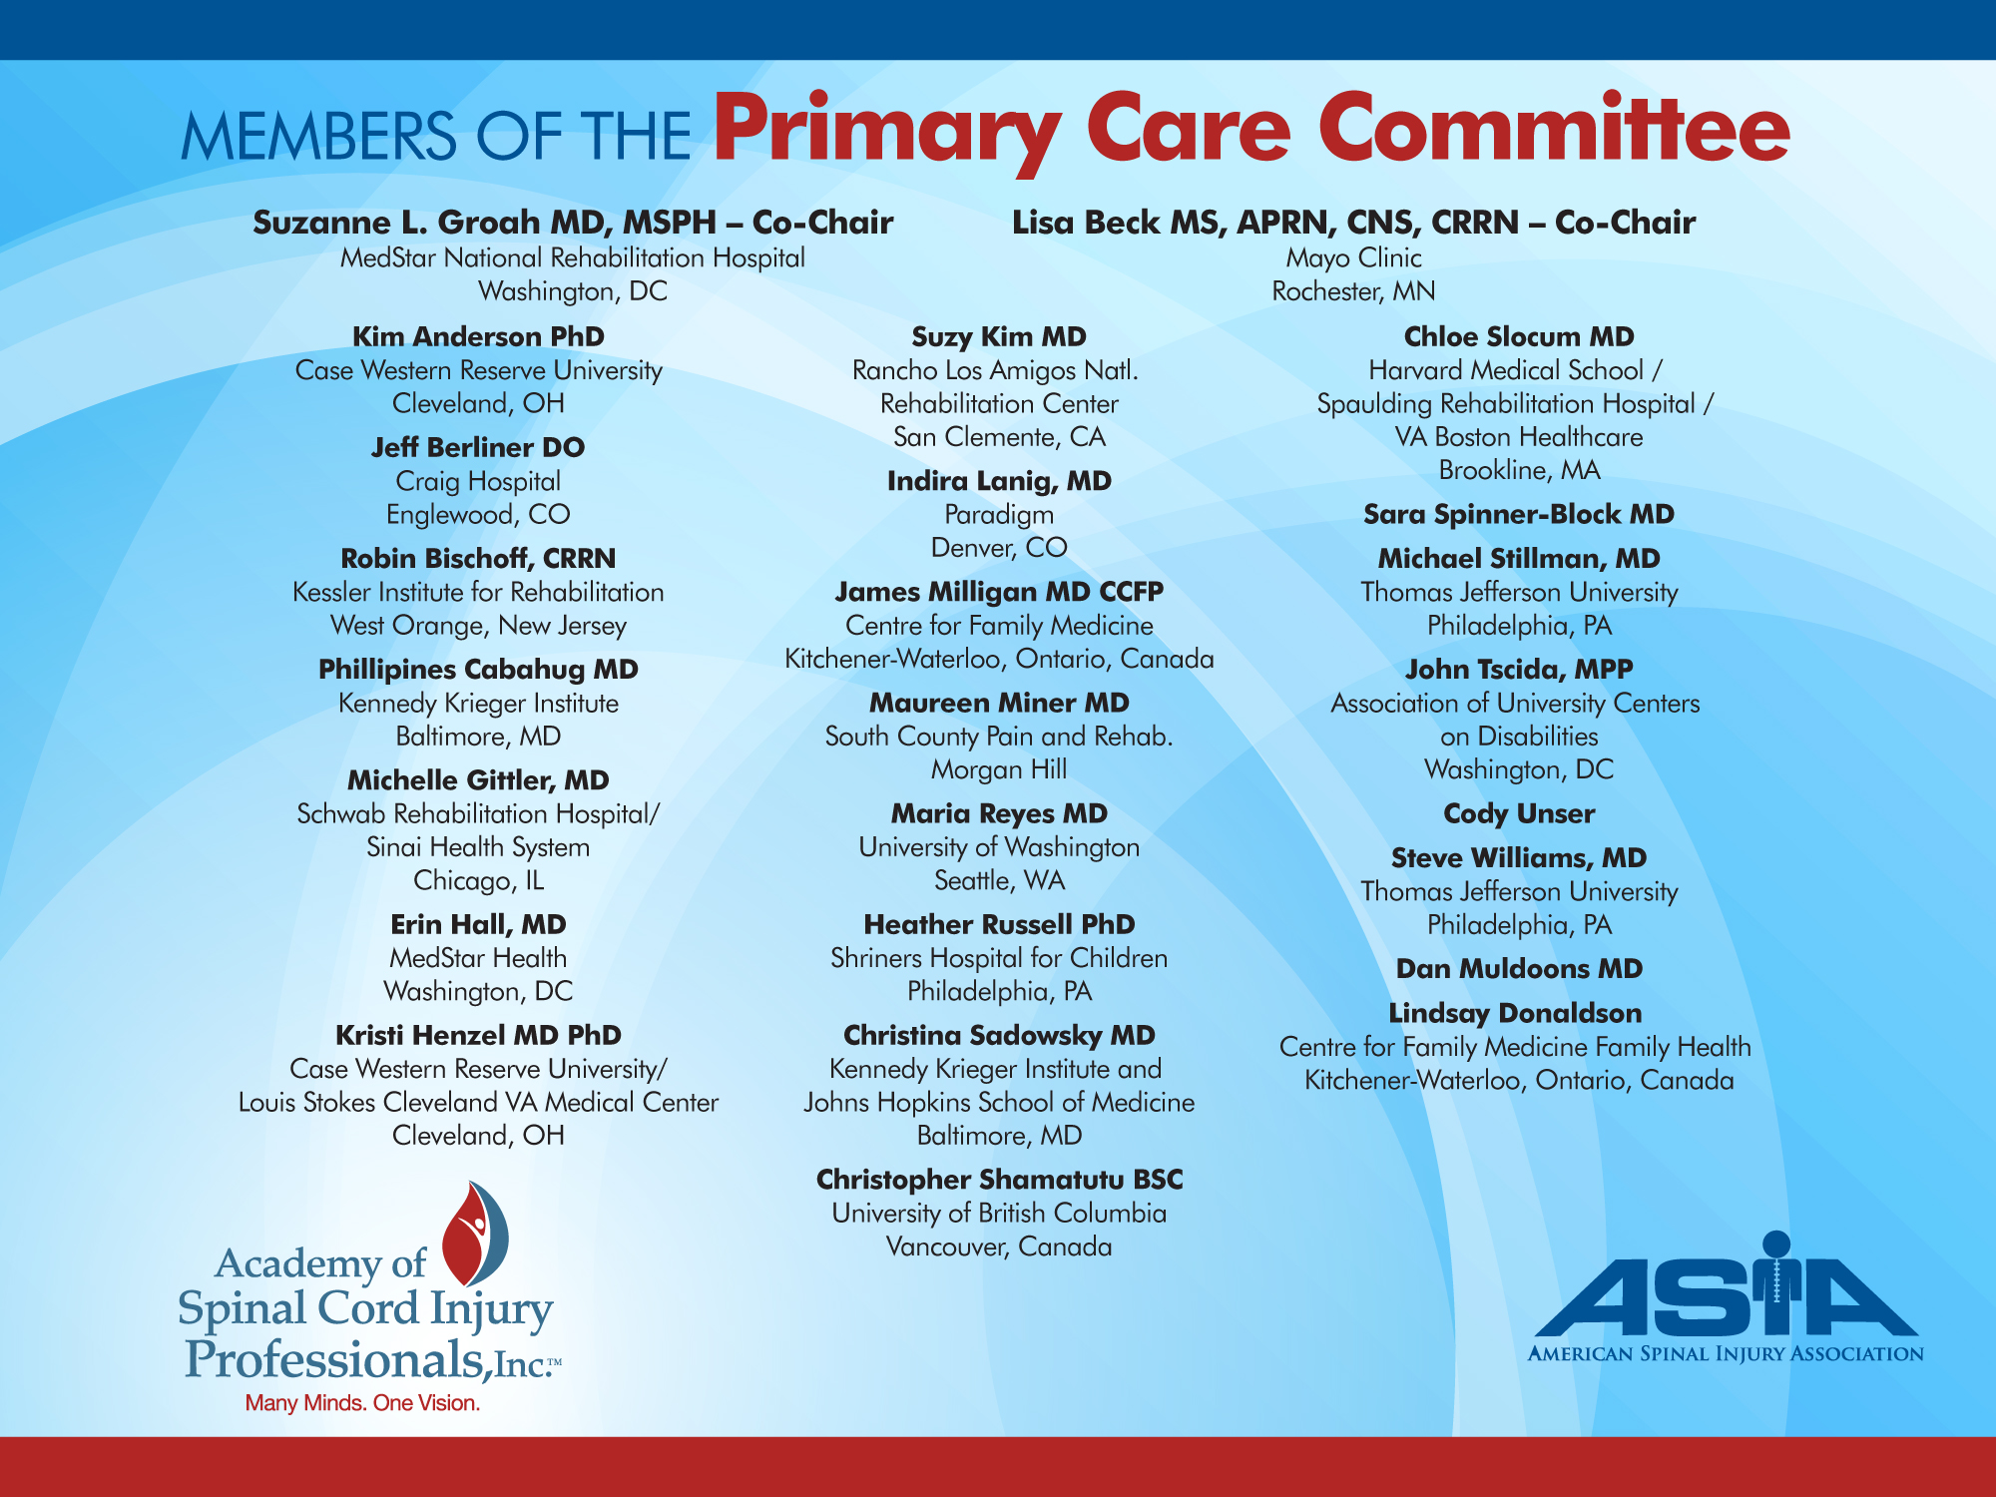

Slide 4
Primary Care for Persons with Spinal Cord Injury or Disease
Robin Bischoff, CRRN Kessler Institute for Rehabilitation
rbischoff@kessler-rehab.com
Michael Stillman, MD Sidney Kimmel Medical College of Thomas Jefferson University
michael.stillman@jefferson.edu

Slide 5
Conflicts and Disclosures
The presenters have no financial conflicts of interest relative to this presentation

Slide 6
Goals and Learning Objectives
1) Review basic demographics of spinal cord injury (SCI)
2) Present data on outpatient health care utilization by people with SCI
3) Discuss major “secondary effects” of SCI and basic management
4) A call to action and advocacy
Notes:
Also want to mention that even though this presentation is SCI-specific, some of the secondary effects of SCI that we’ll mention can be found in other neurological diseases like Parkinson’s, ALS, MS, and spinal bifida.

Slide 7
Spinal Cord Injury (SCI) Demographics
• Approximately 17,730 new cases of SCI/yr in the United States
• Approximately 291,000 people in the United States living with SCI
• Average age at injury is 43; 78% of recent injuries are in men
• MVA accounts for 39.3% of SCI; falls for 31.8%
National Spinal Cord Injury Statistical Center “Spinal Cord Injury Facts and Figures at a Glance 2019” http:nscisc.uab.edu/Public/Facts%20and%20Figures%202019%20-%20Final.pdf
Notes:
Ask how many audience members help take care of people living with SCI
Also mention that violence accounts for around 13% of SCI and sports another 8%

Slide 8
Health Care Utilization
Stillman et al. Health care utilization and associated barriers experienced by wheelchair users: A pilot study. Disabil Health J. 2017; 10(4):502-8.
Notes:
HIGH UTILIZERS OF OUTPATIENT HEALTH CARE SERVICES. This study was about wheelchair users, but a large plurality had SCI
Majority of respondents had made at least 3-5 visits to each type of doc in the preceding year, but a substantial number had made many more than that (20% made 6-10 visits). Compare with national average of around 3.5 visits to any health care provider.

Slide 9
Life Expectancy in SCI
Life expectancy for spinal cord injuries in the U.S. for those who survive at least one year post-injury as of 2018, by age and severity. https://www.statsta.com/statistics/640901/life-expectancy-spinal-cord-injuries-persons-who-survive-one-year/
Notes:
Despite coming to see physicians frequently, mortality rates are unfavorable. And, this is a big deal in the SCI community right now. How can we properly address and correct this?

Slide 10
Accessibility Barriers
Stillman et al. Health care utilization and associated barriers experienced by wheelchair users: A pilot study. Disabil Health J. 2017; 10(4):502-8.
Notes:
We also know that people with SCI face a good number of accessibility challenges when facing outpatient health care services, so it’s difficult for them to receive thorough and equitable care.
This is from that same study of wheelchair users, but we did a subset analysis of the 108 respondents with SCI, and their reports were even more alarming.
Confirmed a couple of years later (Hamilton et al). Study of 140 folks with SCI in Texas. Similar findings. On the order of 20% found doorways and restrooms inaccessible, while around 50% found tables inaccessible.
Does this resonate with anyone? Do any of you find that your clinics spaces are less that wholly accessible to people with significant mobility disabilities and to wheelchair users?

Slide 11
Cancer Screenings: SCI vs National Cohort
% Who
Have
Received
Screening
Stillman et al. Health care utilization and barriers experienced by individuals with spinal cord injury. Arch Phys Med Rehabil. 2014;95(6):1114-26.
Notes:
We also know that people with SCI don’t get the routine and preventive care they ought. This was a particularly well educated cohort, so the discrepancy wasn’t as glaring as it’s been in other studies. But, it is noteable that 1/3rd to ½ of the people who hadn’t had these screenings said it’s was because they couldn’t find accessible facilities or that they’re PCPs had never offered them screenings.

Slide 12
Receipt of Preventive Care in the VA System
SCI non-SCI
CRC Screening 59 72
Dental Care 56 69
Mammography 84 91
PAP Smear 88 98
LaVela et al. Disease prevalence and use of preventive services: comparison of female veterans in general and those with spinal cord injuries and disorders. J Womens Health. 2006;15(3):301-11.
Notes:
Confirmed in this study by LaVela et al

Slide 13
Quality of Physical Examinations
% of Participants
Stillman et al. Health care utilization and barriers experienced by individuals with spinal cord injury. Arch Phys Med Rehabil. 2014;95(6):1114-26.
Notes:
Finally, we know that the physical examinations/evaluations people with SCI receive tend not to be so thorough. These data were from our subset analysis of people with SCI. Most are routinely examined while fully clothed and seated in their wheelchairs. Does this resonate? How do most of you examine your patients who are wheelchair users? Complicated issue. Many barriers to doing complete physical examinations.
Notably, nearly 65% of our respondents reported that their PCPs understood their SCI-specific health care concerns no more than moderately well; only around half were satisfied with the quality of their primary care. And we know why this is. There are only a couple of studies addressing disability-specific education at the UME and GME level, but they confirm that none of us receives the type of information that will arm us to better care for people with disabilities. I certainly didn’t, either during medical school or during my IM training.
This is why we decided to form this working group and to reach out to PCPs. To try to address gaps in education surrounding the care of people with disabilities and to begin to open discussions about how we as a medical community can think about doing better.

Slide 14
SCI and its Systemic Effects
COMPLICATIONS FOLLOWING SPINAL CORD INJURY
Notes:
SCI can be attended by a number of “secondary effects,” mostly the result of being non-weight bearing (leading to osteoporosis), autonomic dysfunction, sensory impairment, and altered motor function. We’re only going to review the “major” complications of paralysis—those that we thought every PCP should be aware of—but you can see that people who primary care for people with SCI have to be attuned to and vigilant about a great deal.

Slide 15
Preventive Health after SCI
Immunization
Annual influenza
Pneumococcal vaccination
Lifestyle
Inquire about smoking or vaping
Inquire about alcohol and drug use
Cancer Screenings: Particularly for Women
Exercise: Cardiorespiratory
30 minutes of moderate/vigorous intensity aerobic exercise three times each week
Three sets of strength exercises for each major functioning muscle group twice per week

Slide 16
Preventative Health after SCI
Obesity is common
BMI>22 as cut off
Nutrition
Require fewer calories
Mediterranean plan
Dyslipidemia and Glucose metabolism
Initial screen, repeat every 3 years
Hypertension
B/P at every routine visit

Slide 17
Pain in SCI: A Very Nasty Problem
• Between 64 and 88% of people living with SCI have chronic pain
• Between 65 and 78% of people living with SCI have spasticity
• Ameliorating pain is frequently listed as a high health-related priority by people with SCI
Adriaansen et al. Secondary health conditions and quality of life in persons living with spinal cord injury for at least 10 years. J Rehabil Med. 2016;48:853-60
Ataoglu et al. Effects of chronic pain on quality of life and depression in patients with spinal cord injury. Spinal Cord. 2013;51:23-26.
Anderson KD. Targeting recovery: priorities of the spinal cord-injured population. J Neurotrauma. 2004;21(10):1371-83.
Notes:
Pain in SCI can be visceral, myofascial, or neuropathic. Altered/diminished sensation doesn’t preclude sensing pain, but can make evaluation difficult. Good physical exam is critically important.

Slide 18
Efficacy of Approaches to Pain in SCI
• Mailed survey about approaches to pain by people with SCI
• Insight into perceived efficacy and continuation of a number of medications and therapies
Cardenas et al. Treatments for Chronic Pain in Persons with Spinal Cord Injury: A Survey Study. J Spinal Cord Med. 2016;29(2): 109-117.
Notes:
Unfortunately, the data behind many of the meds we use aren’t that great.
This study by Cardenas gave us our first glimpse into the patient’s voice.
Cardenas sent surveys to 399 people with SCI in the Seattle area. Response rate around 50%. Asked about approaches to pain and efficacy. Asked about traditional meds (gabapentinoids, TCAs, Benzos, opiates) and more complementary approaches (massage, icing, medicinal cannabis, etc.). Among the scripts, opioids provided the greatest relief (6.2/10), but provided just several hours of relief. Among the less traditional approaches, MC scores 6.6/10. Of note, among the people with the most severe pain, less than half were on scripts that had been prescribed for them in the past. They’re simply not that effective, and their side effects can be quite severe.

Slide 19
CanPain Guidelines of 2016
 | First-Line | Second-Line | Third-Line | Fourth-Line
Gabapentinoids | x
Amitriptyline | x
Tramadol |  | x
Lamotrigine |  | x
Transcranial stim |  |  | x
Transcutaneous stim |  |  |  | x
Oxycodone |  |  |  | x
Guy et al. The CanPan SCI Clinical Practice Guidelines for Rehabilitation Management of Neuropathic Pain after Spinal Cord Injury: Recommendations for Treatment. Spinal Cord (2016) 54, S14-23.
Notes:
These are the most comprehensive recommendations to date. Of note, the authors didn’t recommend against Duloxetine (or medicinal cannabis), they just said that there are insufficient data to recommend. Also note the problem. The meds that are recommended are the very meds that the participants in Cardenas’ study rated as relatively ineffective.

Slide 20
Perceived Efficacy of Medicinal Cannabis (MC)
Table 2. Attitudes towards Cannabis as Medicine
Perceived Efficacy | Total (n=129) % | Current Users (n=99) | Past Users (n=30) | Significance X² (p)
Has allowed me to reduce or discontinue other meds? | 61.20% | 66.70% | 43.30% | 5.28(0.032)
Scripts w/ “much worse” effects than MC | 37.20% | 42.40% | 20.0% | 4.96(0.031)
Scripts w/ “somewhat worse” effects than MC | 18.60% | 20.20% | 13.30% | 0.72(0.593)
MC has greater efficacy than scripts | 63.30%
Only MC offered me relief | 10.20%
I have suffered symptoms not helped by MC | 35.20% | 31.60% | 46.70% | NS
Notes:
National study of 353 people with SCI and their history with cannabis. Over half identified as either current or past users of medicinal cannabis. Notable that 63.6 reported that MC had offered great relief and 30.2% that it had offered a little relief. 6.3% that there was no relief or made the symptoms worse. We mention this because MC is legal in NJ. And, while SCI isn’t specifically an indication, chronic pain and intractable spasticity are. So, MC may be a good option for your patients who aren’t finding relief with more traditional meds.
So, what about MC?

Slide 21
Dysautonomia Following SCI
• Orthostatic Hypotension (OH):
-Drop in SPB of > 20 mm Hg or DBP of > 10 mm Hg while assuming upright position.
-Usually symptomatic, though many people with SCI have low resting BP
-Up to 74% of people with cervical and high thoracic SCI experience OH
• Autonomic Dysreflexia (AD): Medical Emergency
-A response to noxious stimulus; usually in people with SCI at T6 or above
-Cardinal finding is elevation of SBP of at least 20 mm Hg, but also HA, sweating above level of injury, anxiety, blurred vision.
-80% of episodes due to urinary or fecal retention
-Faaborg et al. Autonomic dysreflexia during bowel evacuation procedures and bladder filling in subjects with spinal cord injury. Spinal Cord. 2014;52:494-98.
-Krassioukov et al. International standards to document remaining autonomic function after spinal cord injury. Top Spinal Cord Inj Rehabil. 2012;18:282-96.
-Claydon et al. Orthostatic hypotension and autonomic pathways after spinal cord injury. J Neurotrauma. 2006;23:1713-25.
Notes:
Complicated pathophysiology, but have to do with imbalance between parasympathetic and sympathetic inputs. Of note, AD is considered a medical emergency, as it can lead to retinal and intracranial bleeds, Mis, strokes, and even death.

Slide 22
Causes of AD Symptoms of AD
Bladder Bowel Pressure Sores Tight Clothing Fractures Ingrown Toenail DVT or PE Body Positioning Invasive Procedures Hemorrhoids Heterotopic Ossification Labor and Delivery Menstruation Intercourse Pain Functional Electrical Stimulation
Pounding Headache Elevated Blood Pressure Bradycardia Flushing of the skin above level of injury Goose Bumps Blurred Vision Nasal Congestion Anxiety Could have no other symptoms except elevated BP
Notes:
While most cases are due to bladder or bowel issues, there are many other potential causes, and if there’s not immediate resolution, a thorough evaluation is absolutely necessary

Slide 23
Approaches to Management
Orthostatic Hypotension | Autonomic Dysreflexia
Institute BP monitoring program (may be ambulatory) | Continuous BP monitoring during episode
Stockings, binders, slow transition from recumbent to seated positions | Sit upright. Loosen clothing and devices. Assess need for bladder drainage/bowel evacuation
Vasoconstrictor (Midodrine) and/or volume expander (Florinef) | Continue full physical exam
Consideration of post-prandial hypotension | If BP remains elevated, 0.5 to 1 inch NTP above injury. May also give oral CCB or ACE
 | If no resolution, refer to emergency department
Notes:
Important to note:
-Post-prandial hypotension has to do with post-prandial pooling of blood in splanchnic vessels and an inability to compensate. Unclear prevalence, but thought to be vastly under-diagnosed.
-AD needs to be evaluated and treated quickly.
-Availability of AD wallet cards?

Slide 24
Dysreflexia Takeaway
Never ignore a headache
Be a detective-Find the cause
Usual causes- bladder or bowel
DEATH

Slide 25
Neurogenic Bowel
NBD results from loss of normal sensory or motor control and may encompass both the upper and the lower gastrointestinal (GI) tract. It is characterized by the inability to control stool. Quality of life is greatly affected; patients often find their symptoms to be socially disabling.
Upper Motor-Neuron bowel[ Spastic, Reflexive], present at T12 and above When the bowel becomes full, a BM occurs but in between BMs the anal sphincter stays tight.
Lower Motor-Neuron bowel[ Flaccid, Non-Reflexive] present below T12-L1. The anal sphincter cannot hold stool in and stool will ooze out.
Notes:
UMN most common

Slide 26
Bowel Programs
GOALS
-To prevent accidents -To have a bowel movement at a regular, predictable time. -In a reasonable amount of time
UMN Program
Oral Medications
Digital Stimulation
Chemical Stimulation
Alternatives
Colostomy
Anal Irrigation
MACE
LMN Programs
Manual Evacuation
Maintain Firm Stools
Notes:
Consider premorbid bowel pattern-- Keep program same time And Frequency --Eat or drink something 30 minutes prior to starting program-Consider hydration and diet-Gravity helps-PRIVACY If a pt comes in wearing a diaper you know there is a problem

Slide 27
Bowel Takeaway
QOL
Notes:
If a pt comes in wearing a diaper you know there is a problem

Slide 28
Neurogenic Bladder
Reflexive upper motor neuron injuries T12 and higher - Can’t empty hyper-reflexive
Management
Foley Catheter
Intermittent Catheterization
Medications
Suprapubic Catheter
Areflexic lower motor neuron injuries L1 and lower - Failure to store-flaccid bladder
Condom Catheter
Mitrofanoff
Notes:
CAUTI’S

Slide 29
Bladder Takeaways
Bladder management
Individualized based on hand function, caregiver assistance, body habitus, gender, etc.
Intermittent catheterization often considered optimal
Surveillance
Urinalysis and culture not recommended
Consider annual renal assessment
UTI
Treatment with antibiotics should be based upon culture sensitivities
Only treat symptomatic UTI’s (cloudy and malodorous urine without other symptoms is not considered a UTI)
Notes:
Yearly Urodynamics COMPLIANCE

Slide 30
Resources for Primary Care

Slide 31
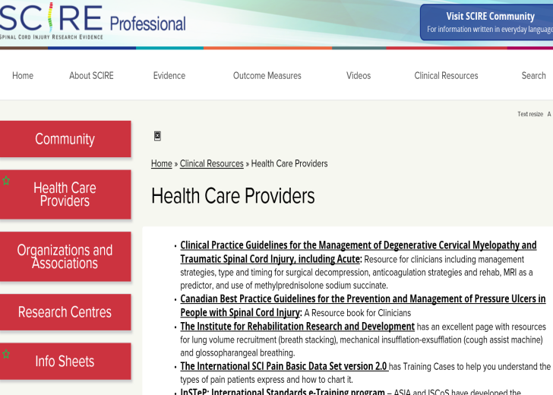
Currently available
https://actionnuggets.ca/
https://scireproject.com/clinical-resources/health-care-providers/

Slide 32
ASIA Primary Care Committee:
Primary care clinicians, SCI specialists, consumers with SCI, researchers, and other SCI stakeholders
Dialogue amongst these groups (and others as needed) with the goal of advancing primary care delivery and services for people with SCI
Open access online special edition for PCP’s and others
Notes:
The two organizations are developing two subsequent issues of Topics in Spinal Cord Injury Rehabilitation, that is written as a resource for PCP.
The articles were co-written by PCP, SCI specialists and a consumer with SCI.

Slide 33
ASCIP/ASIA Future Resources
Joint website page
ASIA and ASCIP
Open access of Topics journal articles
Video record workshop
Develop webinar
Notes:
ASIA and ASCIP are developing a joint web page to host the articles, check lists, webinars that relate primary care of persons with SCI (similar to this talk).
We are also looking into unique apps to host the information, allowing greater access for PRIMARY CARE PROVIDER to the information.

Slide 34
Concluding Remarks
• People with SCI are “high utilizers” of health care, but have poorer health outcomes. How can we address that?
• SCI specialists are available, but we hope to improve PCP awareness of common secondary effects of SCI.
• We know that 30 years after passage of the ADA, health care is still largely inaccessible to people with SCI. What can we do about that?
• Discussion?

